Slide 1
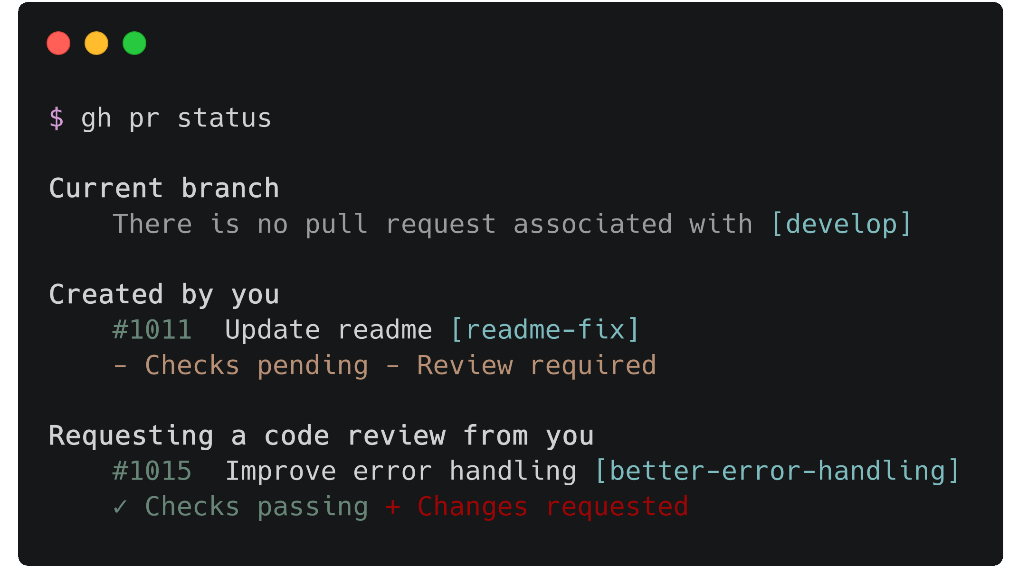
Introducing the GitHub CLI
The interactive command line tool for people who love GUIs
Presented by
Chrissy LeMaire

Slide 2

GitHub Star
Notes:
to qualify for a star you have to be consistently demonstrating leadership in your community and giving back to that community in an exceptional way. Nominate at stars.github.com/nominate

Slide 3

Cloud & Datacenter + Data Platform

Slide 4
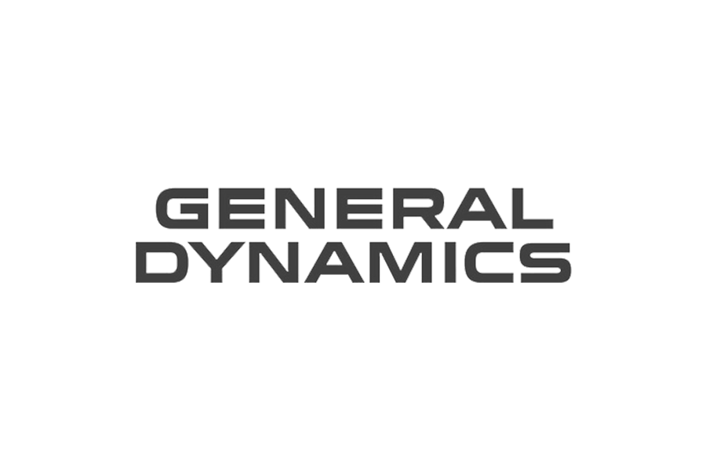
Information Systems Security Officer

Slide 5

Twitter
@cl

Slide 6
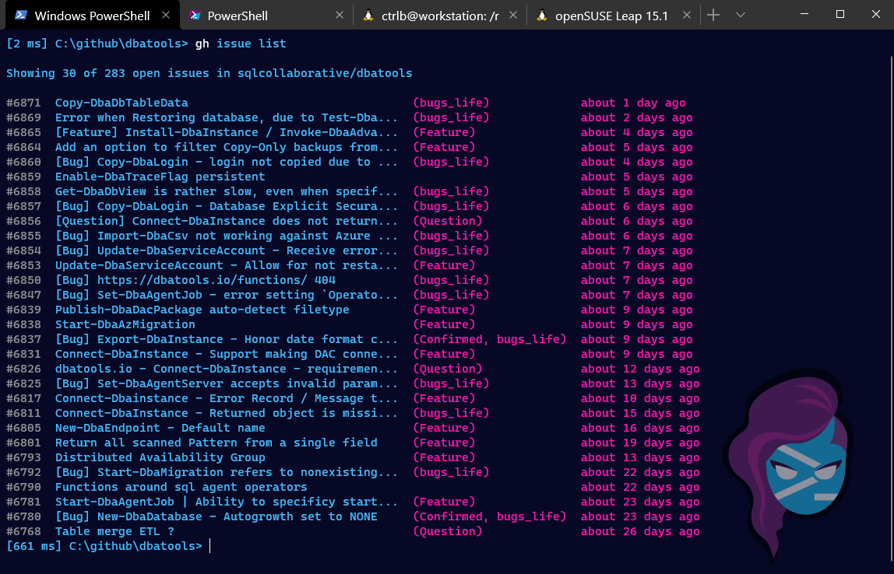
GitHub CLI 1.0
Notes:
gh is designed to be a compliment to the git command line where git does the Git stuff and gh can do the common GitHub stuff that developers want to do from the command line. So branch, commit, push, pull etc all from the git command

Slide 7
GitHub CLI 1.0
It makes creating a new repo or a pull request *so* much faster! ~ @ASpittel
I just love how I can quickly check statuses and open the PR/repo in the browser without managing bookmarks/links. ~ @RafCevallos
Created 6 PRs in a few min, team will love me 😜 ~ @steipete
It works so well. Managing PRs is awesome 🙌🏼 ~@dkcas11

Slide 8
Other Tools
Tool | Chrissy’s usability scale
git | 😫
hub | 🤔
VS Code | 😑
GitHub Desktop | 🤩

Slide 9
Other Tools
Tool | Chrissy’s usability scale
git | 😫
hub | 🤔
VS Code | 😑
GitHub Desktop | 🤩
GitKraken | 🤐
Notes:
cli is that it was a half/half solution
Limited knowledge, feel free to correct me

Slide 10
The Pros & Cons of GUIs
Pros
Prompts for input
Easy to understand visuals and navigation
Condenses complicated processes into simple actions
Cons
Context switching
Lots of clicking
Locked in/can’t extend
Notes:
https://support.gitkraken.com/pdf/infographic/gitkraken-vs-cli.pdf

Slide 11
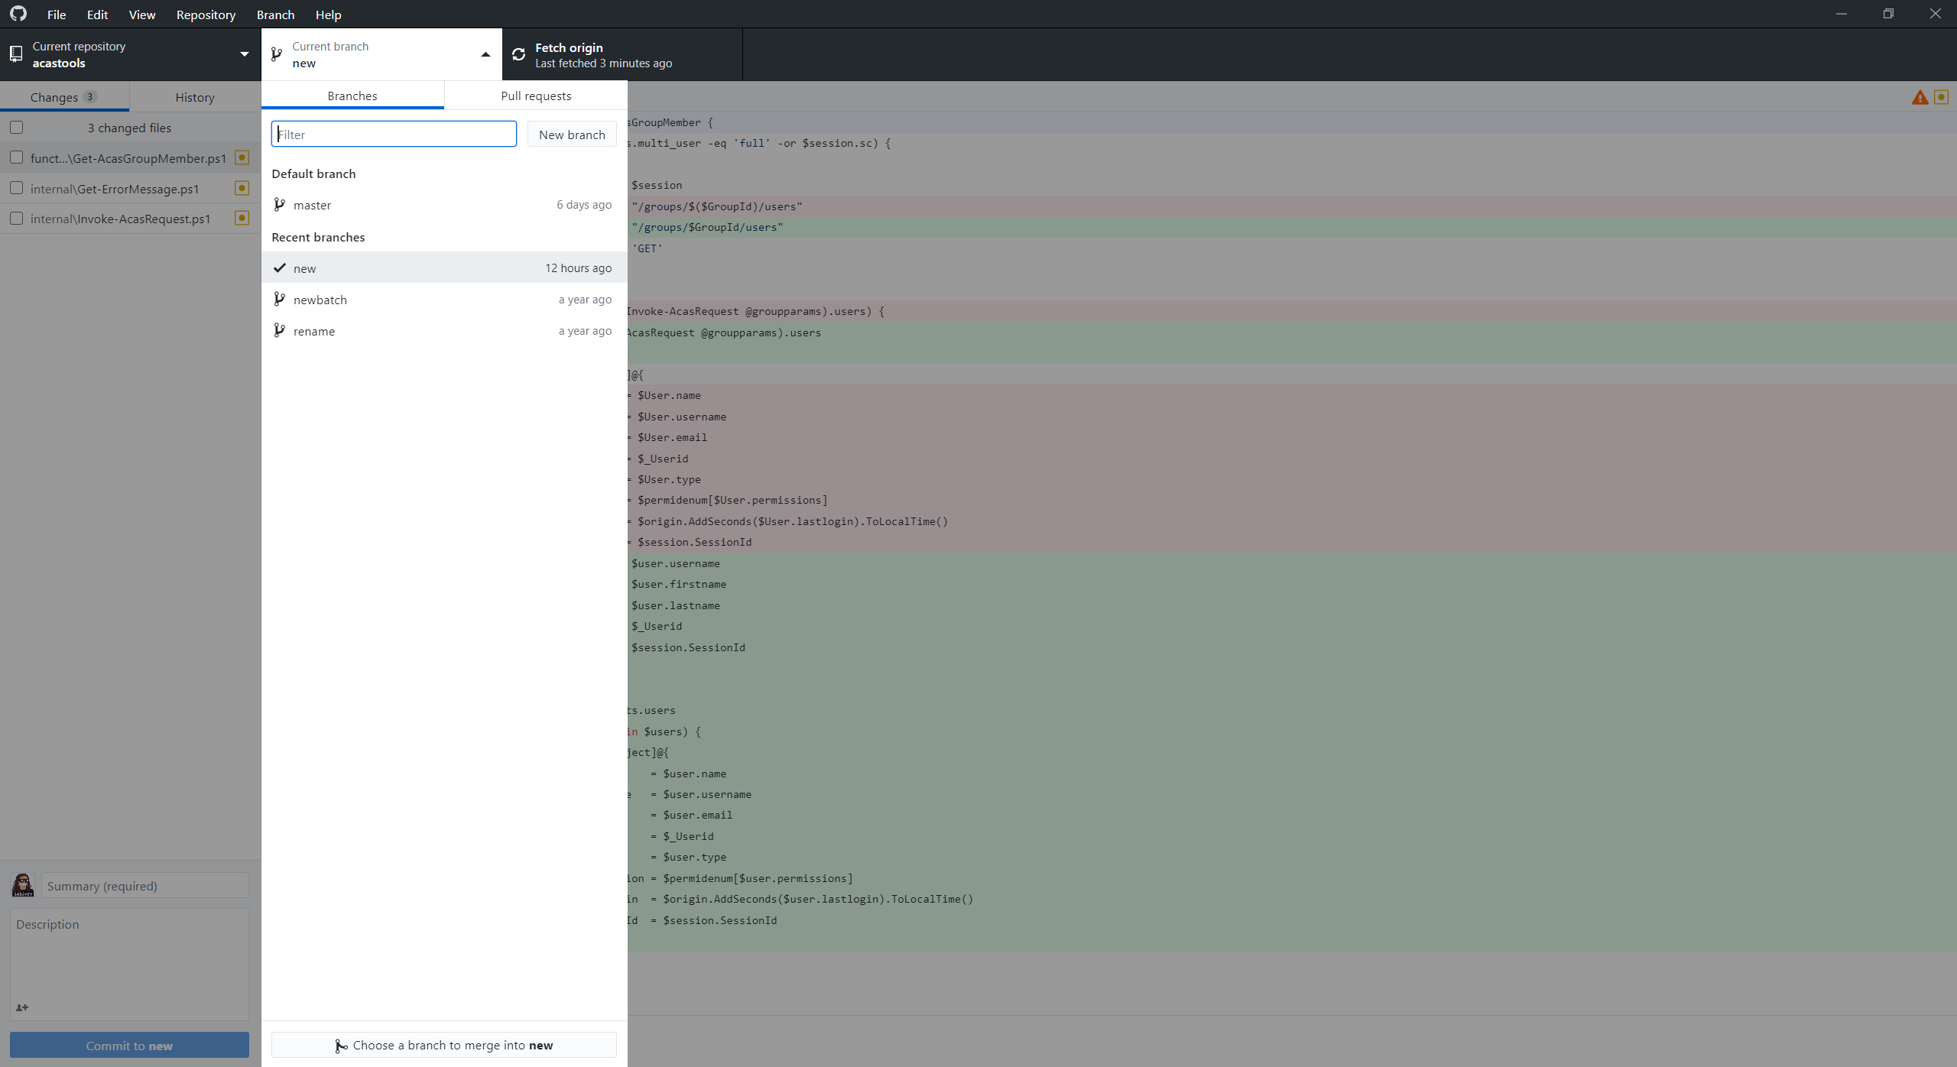
GitHub Desktop

Slide 12
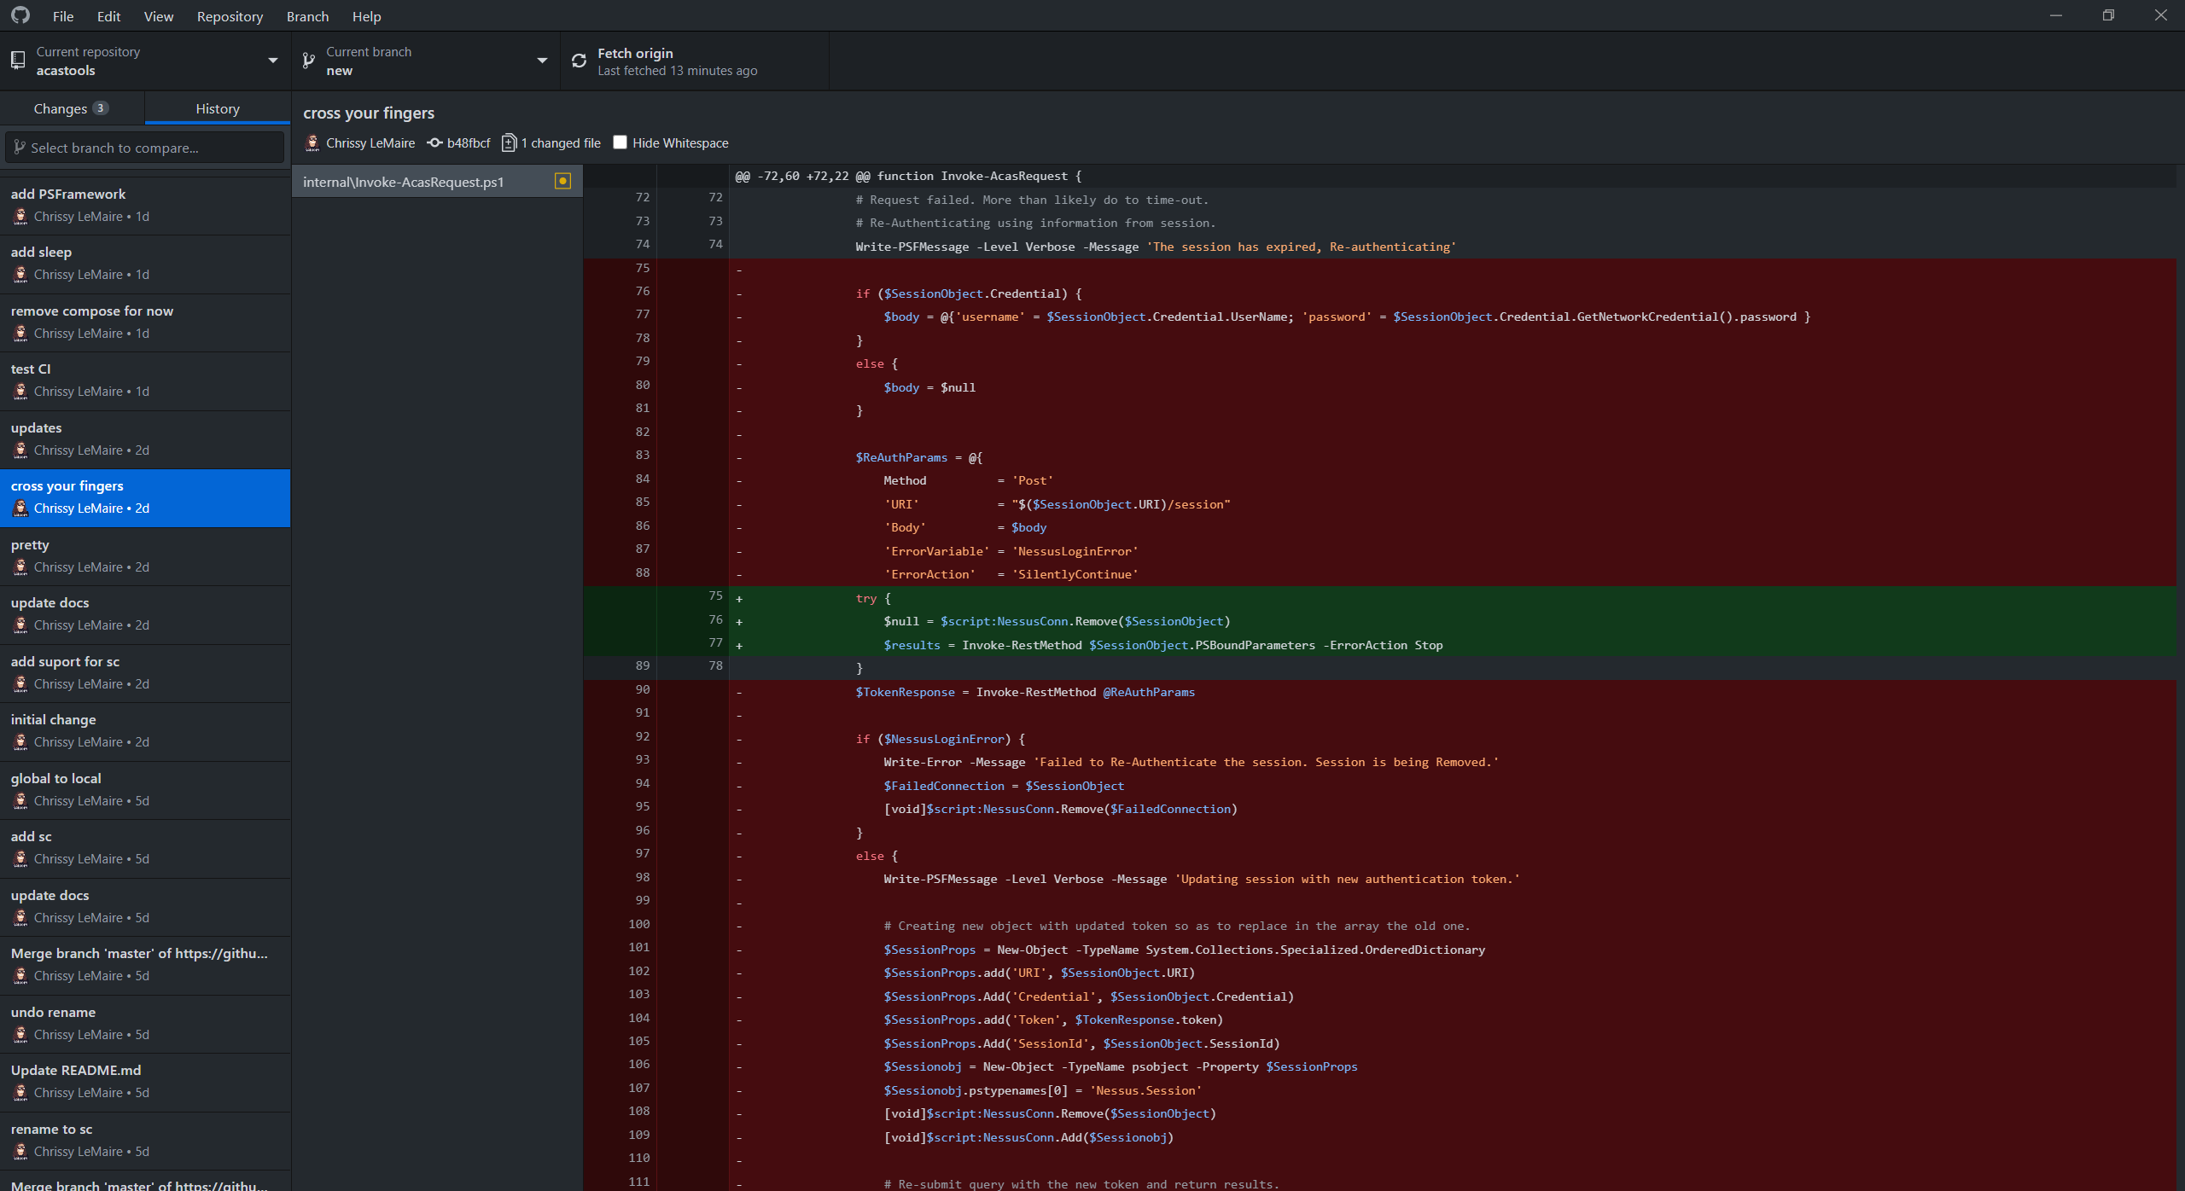
GitHub Desktop
Notes:
Admittedly, I do a lot of context switching

Slide 13
The Pros & Cons of CLIs
Pros
Less context switching
Efficiency once you know what you’re doing
Aliases
Cons
Not often created with the beginners in mind
Gotta remember commands
Can be confusing if lots of information is presented
Notes:
With that in mind, let’s go see how the GitHub CLI tackles common cons of the CLI with the pros of GUIs

